Slide 1
BIG MART DATA VISUALIZATION
Date : 24-10-2021 SYED RAHMAN AHMED
1604-19-737-306

Slide 2
Final Outcomes :-
Data Collection and Analysis
Graphical Representation
Data Pre-Processing
Label Encoding
Splitting / Training and Testing

Slide 3
Problem Statements
The Main task is to create a model that can predict the sales.
Using the model ‘BIGMART’ will try to understand the properties of product and sales which plays key role in increasing ’SALES’

Slide 4
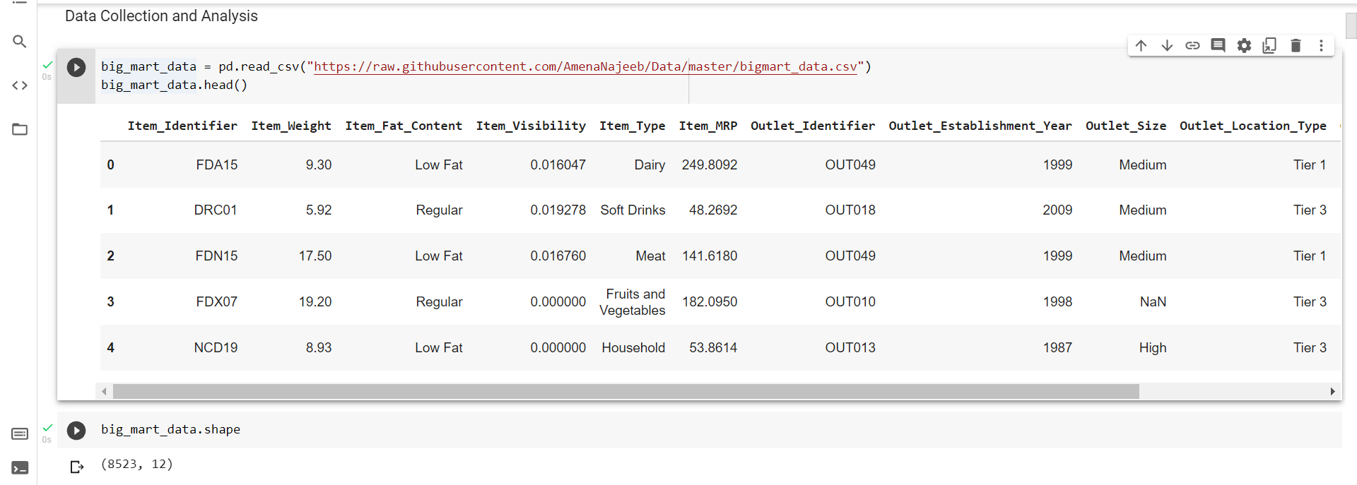
Dataset
Collecting the data from the CSV file

Slide 5
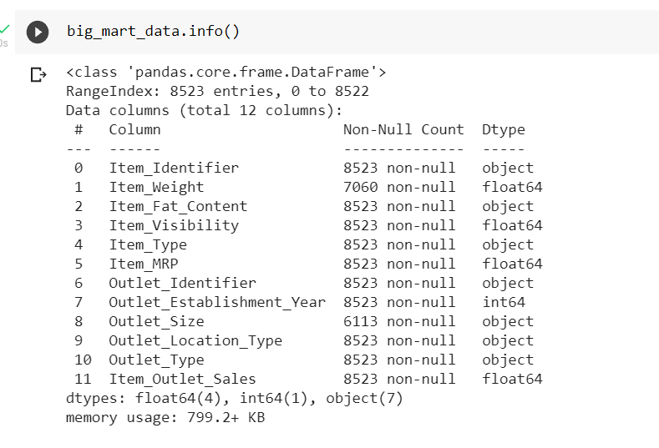
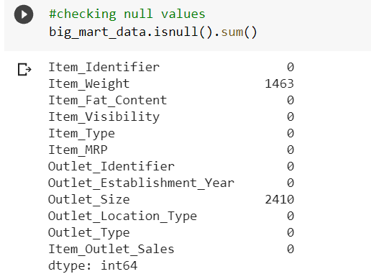
Exploratory Data Analysis
Finding The Null Values in the Data Set
Type of Values each Column consist off

Slide 6
Data Pre processing
Handling The Null Values By :-
Converting the Null Values of 'Item_Weight’ with its MEAN value
Simillarly , Converting the Null Values of ‘Outlet_Size’ with its MODE value
Handling of Null Values has done to reduce the number of Outliers from our Data Set

Slide 7
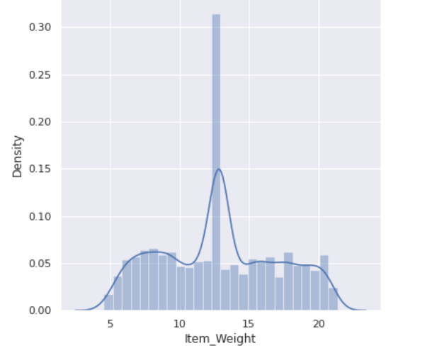
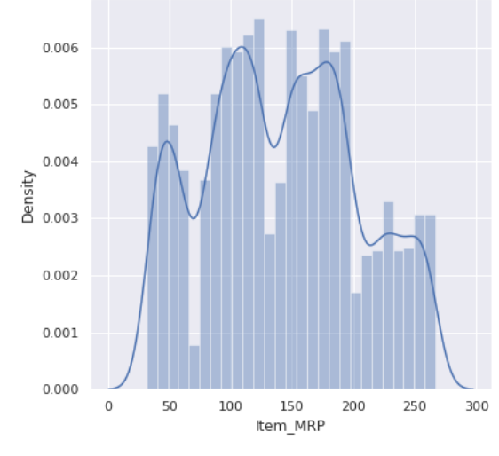
Data Visualization
The Maximum values is around 12kg weight which are highly sold
The Product which have MRP in the range of 100 – 170 are highly distributed

Slide 8
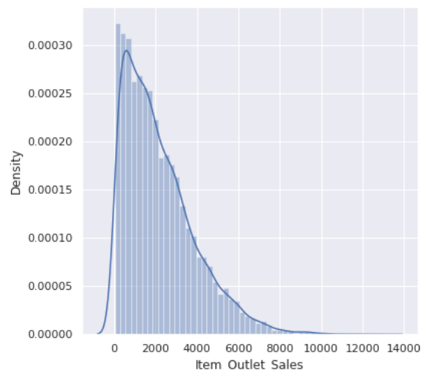
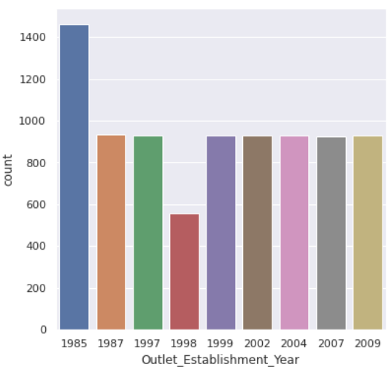
Data Visualization (cont..)
The Maximum Sales are in the range of 10,000 to 2000
The Maximum no. of Outlet were Established in the year of 1985

Slide 9
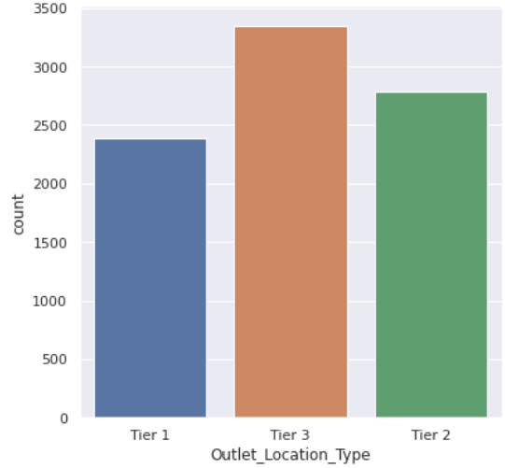
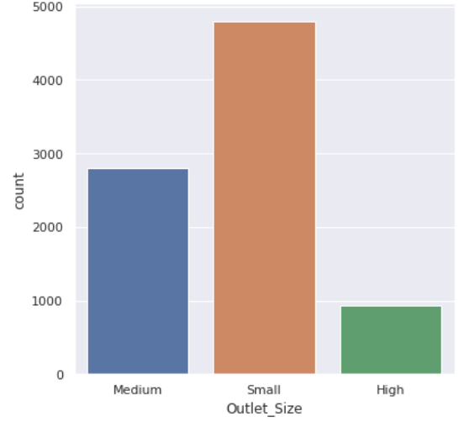
Data Visualization (cont..)
The Tier 3 Type Location has the maximum distribution which effects the sales
The Small Outlet size has the highest distribution

Slide 10
Conclusion
The Outlet_Sales has been affected with various columns of the Data Set which are:-
Item_Weight
Item_MRP
Item_Outlet_sales (etc)
According to the prediction ‘Item_MRP’ column is mostly affecting the sales

Slide 11
Thank you

